Slide 1





PS 5 — Autonomous Operations Intelligence Desk
TEAM MEMBERS-
1) ANIRUD A(LEADER)
2) ANVITHA MOHAN
3) ARPIT PANIGRAHI
4) HARKEERAT SINGH

Slide 2


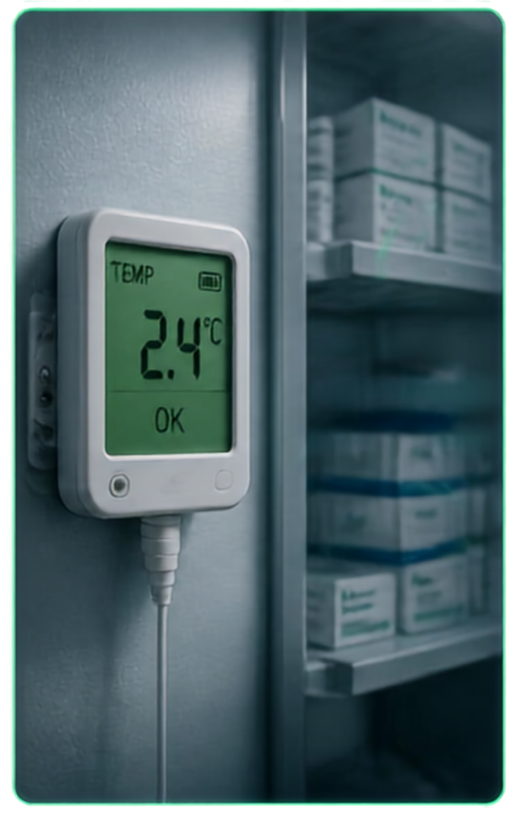







ALERT
ALERT
ALERT
An AI-Assisted Operations Desk for Vaccine Cold-Chain Management
ALERT
ALERT
VaxKavach
ALERT
Preventing failures before they happen — Protecting vaccines, ensuring WHO/FDA compliance, and preventing INR 8+ Cr losses per incident.
ALERT
ALERT

Slide 3


Cold-Chain Failures: Silent & Costly
DISCONNECTED DATA SILOS
FRAGMENTED SENSORS (GPS, TEMP, DOORS, TRAFFIC) ARE MONITORED IN ISOLATION. OPERATORS SUFFER ALERT FATIGUE WHILE ANOMALIES GO UNCORRELATED.
THRESHOLD-ONLY REACTIVITY
RIGID ALARMS ONLY BEEP AFTER CROSSING 8°C WHEN THERMAL DAMAGE HAS ALREADY OCCURRED. NO PREDICTIVE RATE-OF-CLIMB (dT/dt) WARNING.
INR 8+ CR / $1M+ PER INCIDENT
50% OF VACCINES WASTED GLOBALLY (WHO). HEAT-DAMAGED VACCINES LOOK IDENTICAL TO POTENT ONES, CAUSING SEVERE HEALTH RISK & REPUTATIONAL DAMAGE.

Slide 4








Operations Intelligence Desk:
AI-Driven Cold-Chain Monitoring
An AI-assisted operations desk that unifies data, detects issues early, and drives faster, smarter decisions across the cold chain.
Correlate
Identify
Recommend
Audit
Fuses Temp, dT/dt, Door state, GPS & ambient heat into a single operational event
Arrhenius Mean Kinetic Temp (MKT) & rate-of-climb quantify true biological damage
Cryptographic SHA-256 hash chain guarantees tamper-evident WHO GDP compliance
PostGIS spatial engine dispatches nearest certified depot reroutes & Telegram bot cards
Built to meet PS 5 operational needs: Watch, Spot, Explain, Recommend, Act, and Record — Every degree, accounted for.

Slide 5
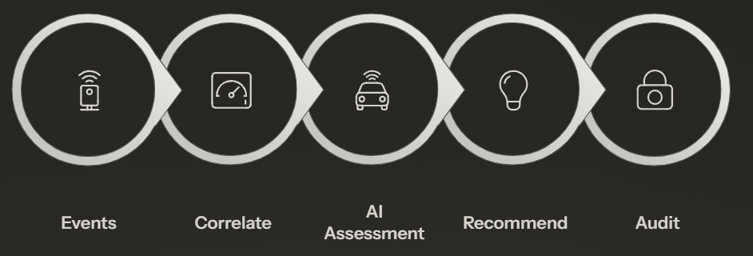
End-to-End Intelligence Flow

Slide 6






Incident Walkthrough:
From Detection to Resolution
INCIDENT TIMELINE
LIVE INCIDENT VIEW
08:13
08:14
08:15
08:17
08:34
Event Detected
AI Flags Anomaly
Recommendation Issued
Operator Decision
Incident Resolved
Temp rises 4.2°C → 5.4°C on NH48; truck stationary in 36°C ambient heat
Open cargo door (>4 min) + rate-of-climb (+0.8°C/min) flags active excursion
PostGIS plans 11.4km diversion to Sriperumbudur Depot; Telegram alert sent
Supervisor authorizes emergency reroute via Ops Console / Telegram Bot
Safely docked in cooling bay at 3.8°C; SHA-256 cryptographic audit ledger verified
INCIDENT STATUS
RESOLVED
DURATION
21 MIN
IMPACT
INR 1.2 CR LOSS PREVENTED

Slide 7












Why This is the Best Fit for PS 5
BASIC MONITORING DASHBOARDS
OPERATIONS INTELLIGENCE DESK
Disconnected alerts (isolated sensors)
Multi-signal correlation + Arrhenius MKT
Reactive threshold alarms (>8°C only)
PostGIS depot routing + Telegram bot
Mutable logs (no audit protection)
Tamper-evident SHA-256 hash ledger
CORRELATE
IDENTIFY
RECOMMEND
AUDIT
The only platform unifying physics-based intelligence, geospatial action, and cryptographic auditability to power PS 5 cold-chain operations with confidence.

Slide 8

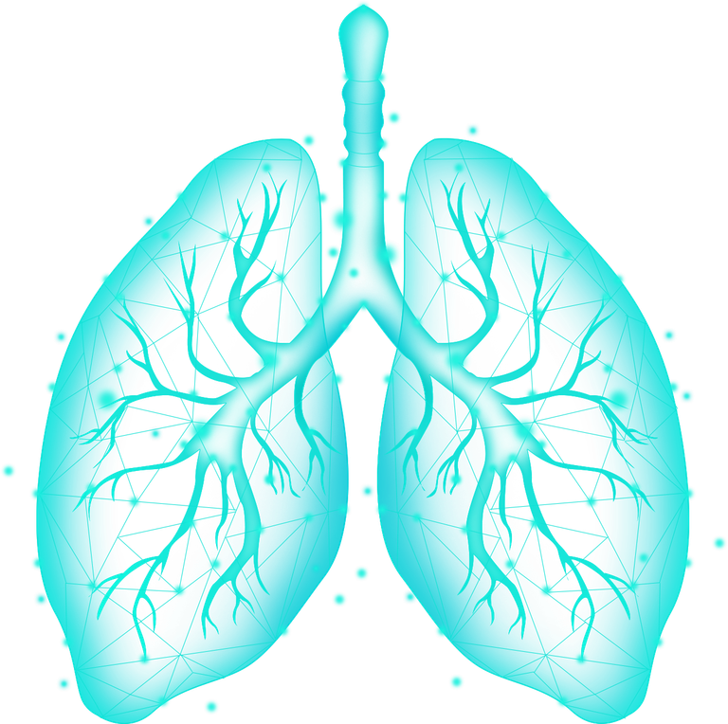
Thank You
VaxKavach — Every degree, accounted for.
Smart India Hackathon 2026 • Problem Statement 5: Autonomous Operations Intelligence Desk

